Slide 1
COMP4342 Group Project Group19
Cheung Sui Wing 21027547D
Lau Man Chun 21027257D
Cheng Chi Kit 21028079D
Kwong Chun Him 21028468D

Slide 2
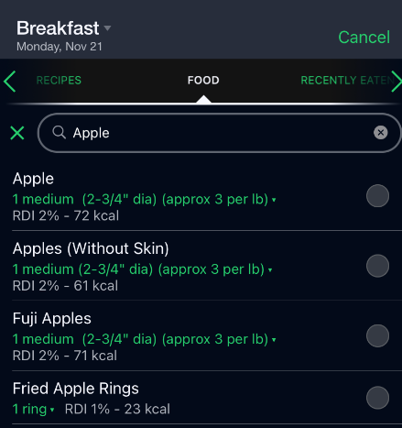
Overview
Diet application
For user to record daily calories absorbed
Existing application example:
User need to input the food one by one to search
Market app: FatSecret

Slide 3
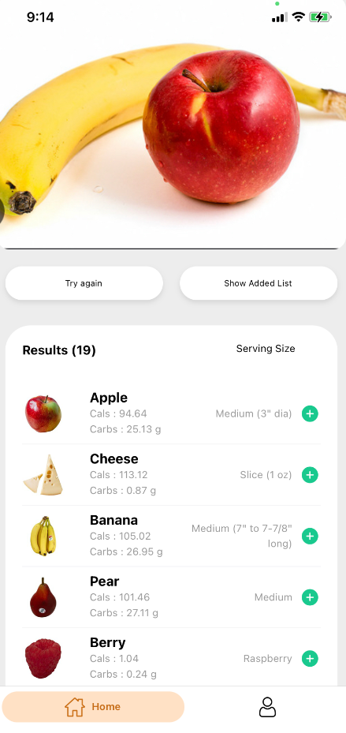
Overview
Not convenient if you need to input so many food
Our App:
← Take/pick a picture of the food
← Get the result by using food recognize

Slide 4
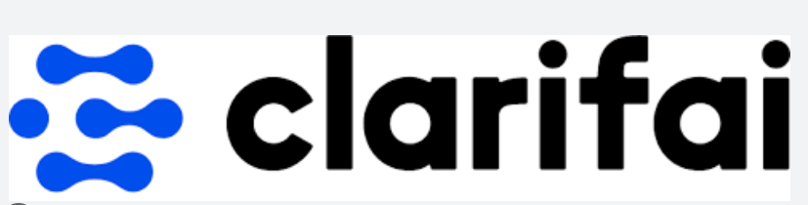

Application logic
We do not train our model or collect food data
Instead, we use two API:
Clarifai → provide free food recognize service
Nutritionix → provide nutrition data for food

Slide 5
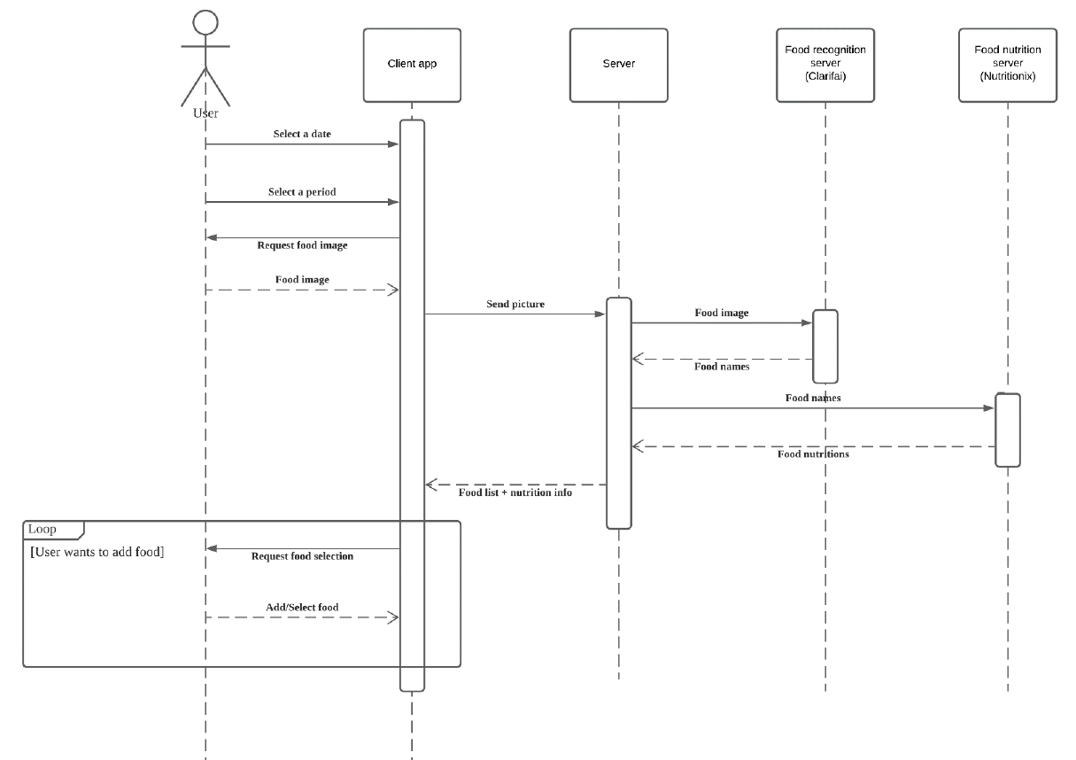
Application logic (main function)
Send picture → backend server
Server send picture → Clarifai (get food recognize result)
Server send the food result → nutritionix (get nutrition data)
Reformat the data → send back to user

Slide 6
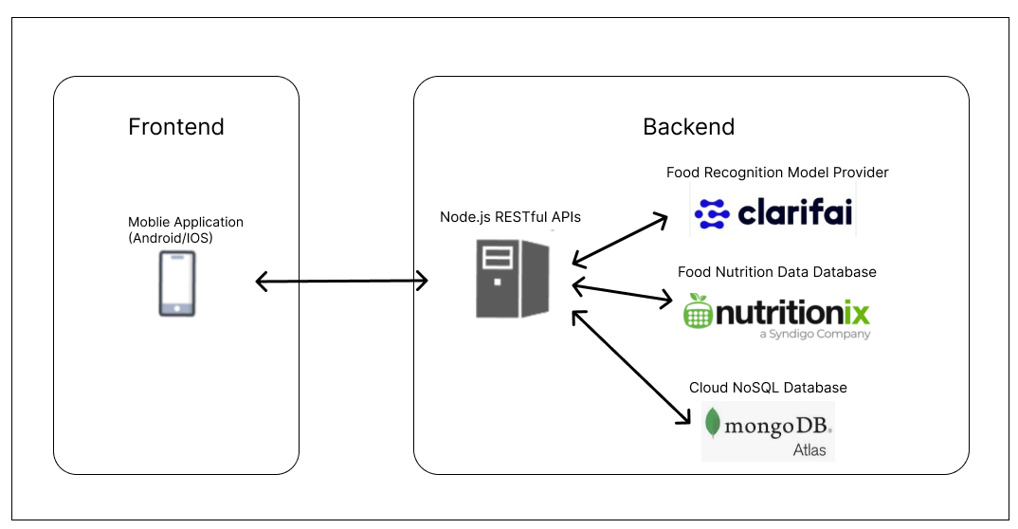
Software architecture
Frontend → Mobile Application
Backend → Restful server
With Clarifai API
Nutritionix API
mongoDB Atlas

Slide 7
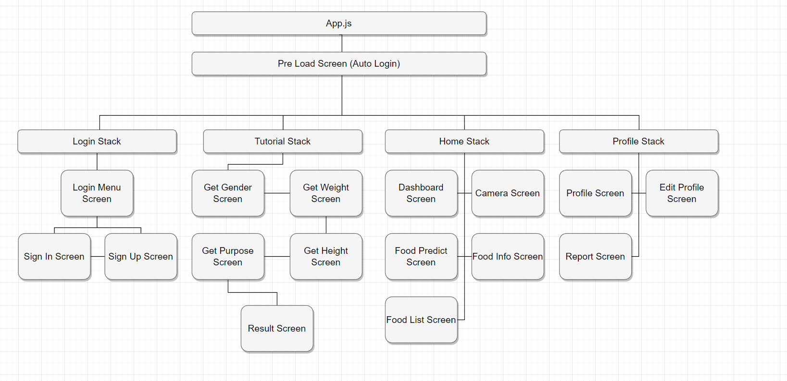

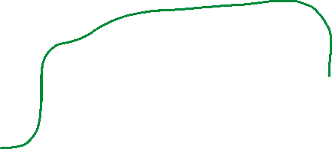

Client-side design
React Native expo
(IOS 13.0+ / Android 5.0 API 21+)
Signin/signup
If New Account, → Go Tutorial Screen
If Not New Account, → Go Home Screen
Store the “user token” for auto login only
Application-side encryption → hash the password before sending it to the server.
All Screen in our app
P.S Tutorial Screen is to lead the new user to input personal information to calculator BMR

Slide 8
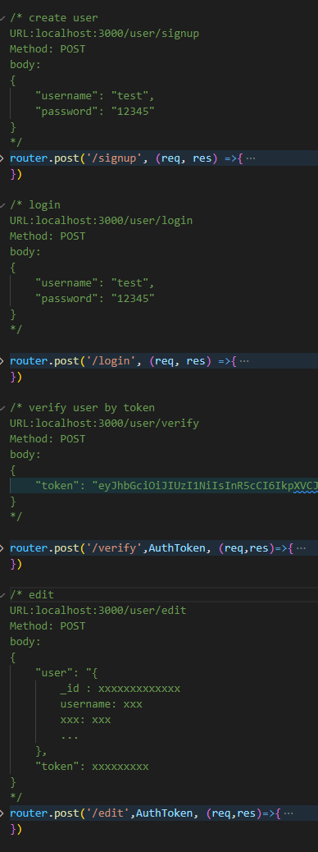

Server-side design
Node.js as the base
Express.js → develop RESTFul API
Mongoose.js → manage the connection of MongoDB altas
Java Web Token → protect our route
1 route for food recognition
4 route for user (Signin/ Signup/ verify/ edit)

Slide 9
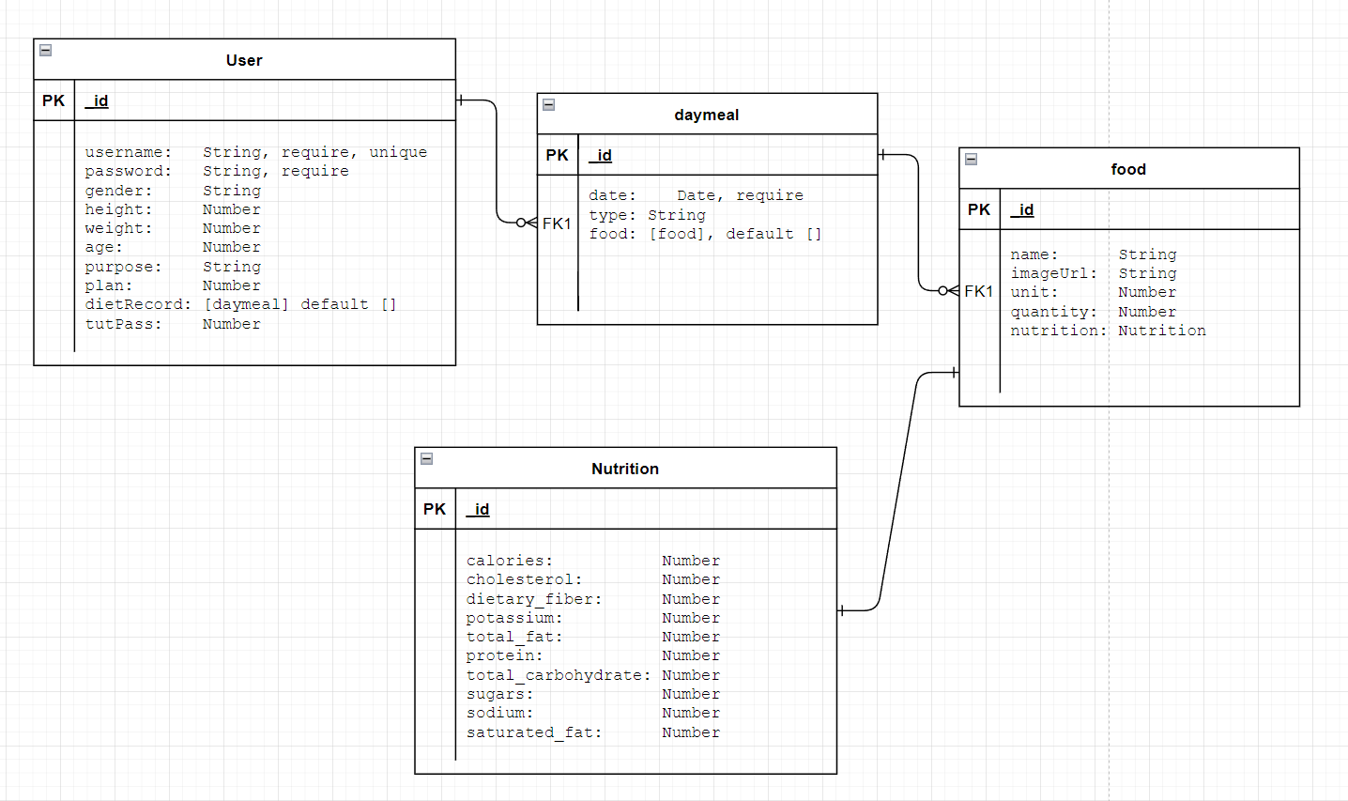
Database
Using MongoDB Atlas
Data model:

Slide 10
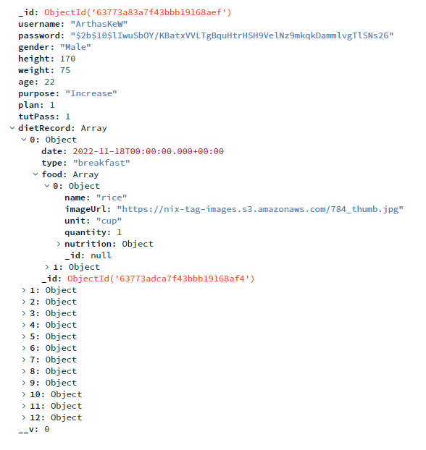
Database
How the data look:

Slide 11
Demo + Q&A

